Slide 1
Managing Your Mood Through Thought and Action
Rona Milch Novick, PhD
Dean

Slide 2
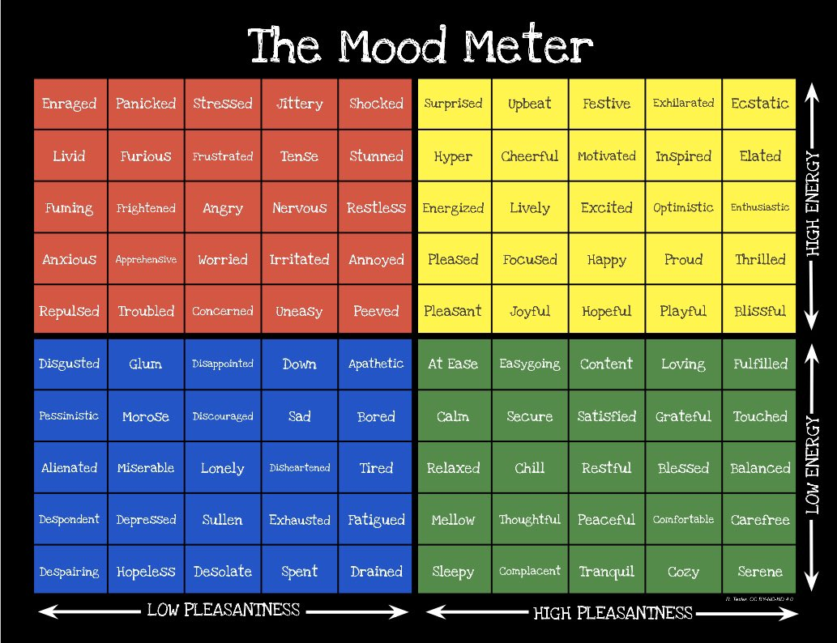

Slide 3
Why Mood Matters
Affects your behavior in the short run
Affects your behavior in the long run
Impacts your relationships with others
It just doesn’t feel good!

Slide 4
What Impacts Mood?
Environment
History/Past
Biology – sleep, nutrition, medications
Behavior
Thinking

Slide 5
What Can You Control?
Environment – some control
History/Past – can change how you think about past
Biology – sleep, nutrition, medications – some control
Behavior – significant control
Thinking – significant control

Slide 6
The Power of Thought
Thought influences behavior, physiology, and other thoughts
Thoughts can have positive, negative or neutral influence
Thoughts can be learned – and can become habitual
Negative thought habits keep us stuck, can be self-destructive

Slide 7
Common Negative Thoughts

Slide 10
Two Essential Questions
Is this thought true?
Is this thought helpful?

Slide 11
Mental Housekeeping
Know your negative thought habits
1
Catch yourself when engaging in negative thought habits
2
Ask the two essential questions
3
CLEAN HOUSE!!!
4
Refocus/reframe
Distraction
Create new mantra - Avoid polyanna statements

Slide 12
Manage Behavior: Manage Mood

Slide 13
Acting Sad . . .
Prescribing normal, happy activities as effective as therapy or medication
Of course, when mood is low, harder to engage in pleasant activities . . . Push yourself

Slide 14
Biology Lesson
You are what you eat (caffeine, alcohol, sugar)
Sleep deprivation – moodiness, irritability, vulnerable to insult/hurt
Exercise – body’s natural stress buster and mood medicine

Slide 15
Good Mood Behaviors
Gratitude
Giving
Mindfulness
Social connection – real not virtual

Slide 16
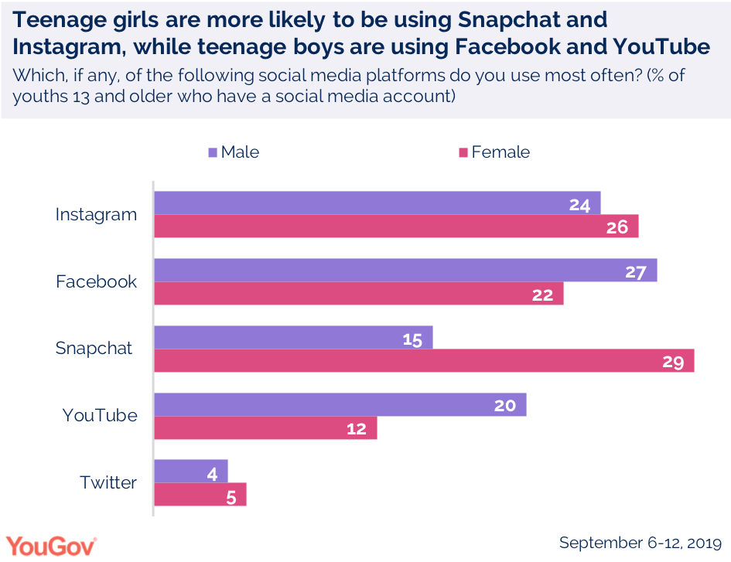

Slide 17
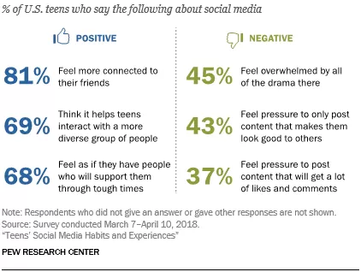

Slide 18
The Challenge of Social Media
Not structured to support mental health
Biased presentation/reporting
Anonymity promotes worst selves – greater cruelty and rudeness

Slide 19
Managing Mood You Don’t Need to Do It Alone

Slide 20
Help is Available
For minor mood management and major psychiatric illness – therapy can help
Short-term focused cognitive therapy, DBT, similar approaches
Medications can be helpful

Slide 21
Conclusion Take Care of Yourself!

