Slide 1
Depression throughout the lifespan
Howard C. Margolese, MD, CM, MSc, FRCPC
Associate professor, department of Psychiatry, Mcgill university

Slide 2
Disclosures
Research Support:
Montreal General Hospital Foundation, AiFred, Syneurx
Consultant and/or Speaker and/or Advisory boards:
Abbvie, HLS Therapeutics, Janssen, Lundbeck, Otsuka, Sunovion, Teva

Slide 3
outline
Introduction
What is depression and what is not depression
Risk factors for depression
Depression in adolescence, midlife, old age
How to treat it
Depression and COVID-19

Slide 4
More than one in ten Canadian adults will develop MDD in their lifetime … ¹
…more than 50% will not be treated
…30-50% will have an inadequate response to treatment
CCHS. Can J Psychiatry 2006;51:84-90;
Hirschfeld et al. Can J Psychiatry 2006;51:84-90;
Lecubrier. J Clin Psychiatry 2007; 68 Suppl 2: 36-41;
Kennedy & Lam. Bipolar Disord 2003; 5 Suppl 2: 36-47.

Slide 5
Prevalence and Burden of MDD
Epidemiology
Canadian Prevalence Estimates
Lifetime: 10.8%
Past Year: 4.0%
Past 30 days: 1.3%
50% of First Lifetime Episodes of Depression are Single Lifetime Episodes of Depression.
Canadian Community Health Survey, Mental Health and Wellbeing. Can J Psychiatry 2006;51:84-90

Slide 6
Causes of Worldwide Disability
1990
2020 (Estimated)
Lower respiratory tract infections
Diarrheal diseases
Perinatal disorders
Unipolar depression
Ischemic heart disease
Cerebrovascular disease
Ischemic heart disease
Unipolar depression
Traffic accidents
Cerebrovascular disease
COPD
Lower respiratory tract infections
Historically, the burden of MDD has been underestimated because burden was assessed primarily using mortality statistics
Murray C, Lopez A, eds. The Global Burden of Disease. WHO;1996
Notes:
Causes of Worldwide Disability
According to World Health Organization (WHO) data, mental health disorders account for 14% of
The global burden of disease worldwide. This is primarily due to the chronic and disabling nature
of depression and other common mental health disorders, alcohol use an substance abuse
disorders, and psychoses.
Among non-communicable diseases, the contribution of mental health disorders to disability is
substantial: in 2005, mental health disorders accounted for more than a quarter (28%) of disability
adjusted life-years, making them the leading contributor among non-communicable diseases to
global disability, ranking higher even than cardiovascular diseases (22%) or cancer (11%).
Key message:
Over the next decade, depression will become the second-leading cause of disability worldwide.

Slide 7
Treatment Gaps In MDD
Although more than 1 in 10 Canadian adults will develop MDD in their lifetime…¹
Up to 50% are untreated^{2,3}
30-50% respond inadequately to treatment⁴
CCHS. Can J Psychiatry 2006;51:84-90;
Hirschfeld et al. Can J Psychiatry 2006;51:84-90;
Lecubrier. J Clin Psychiatry 2007; 68 Suppl 2: 36-41;
Kennedy & Lam. Bipolar Disord 2003; 5 Suppl 2: 36-47.
Notes:
7

Slide 8
Long-term Course of MDD
# weeks depressed in past year
Recurrence MDD: # of lifetime episodes
CANMAT Clinical Guidelines for the Management of Major Depressive Disorder in Adults, J Affect Disord. 2009;
CCHS 1.2, Public Use Microdata File.
Notes:
Long-term Course of MDD
Evidence suggests that major depressive episodes can be long-lasting and recurrent. The Canadian Community Health Survey (2002) reported that the duration of an initial MDE was 2 weeks in 16% of patients, and one month or less in 30%. At the other extreme, 13.7% of the subjects reported that their first episode lasted 5 years or longer.
Importantly, the probability of recovery appears to decline with increasing episode duration, highlighting the importance of early identification and initiation of treatment. Many new-onset episodes occurring in the general population are brief, but longer episodes accumulate to a greater extent and predominate as prevalent cases in the population.
Furthermore, people who experience a first MDE are likely to experience recurrent episodes. In the Canadian Community Health Survey (2002), respondents with lifetime MDD reported a single episode 56.0% of the time, 2 episodes 28.6% of the time and 3 or more lifetime episodes 15.4% of the time. These are underestimates of the frequency of recurrent episodes, as the survey is limited by recall bias.
Key message:
Major depressive episodes can be long-lasting and are frequently recurrent.

Slide 9
Depression – A few other facts
More common in women than men 2:1
Often associated with anxiety disorders and other psychiatric disorders
Often associated with substance use disorders
Depression is often a chronic disease

Slide 10
Symptoms of depression include
Low or irritable mood
Sleep disturbance
Appetite changes
Concentration difficulties
Reduced interest in things
Guilt feelings
Reduced energy
Suicidal thoughts
Psychomotor agitation or retardation

Slide 11
What is Depression?
Symptoms must be present for every day, all day long for at least 2 weeks
Shorter time periods with some of these symptoms present are usually normal variation of mood
Sad mood is also needed, except in adolescents where irritable mood is possible
Grief reactions after a loss is not necessarily depression unless symptoms persist beyond 12 months for adults and 6 months for children.

Slide 12
Depression is a clinically heterogeneous disorder
Sadness
Attention and concentration
Anxiety
EMOTIONAL¹
COGNITIVE¹⁻⁴
Irritability
Short- and long-term memory
Lack of enjoyment
Judgment
Suicidal ideation
Decision-making
Hopelessness
Planning and organisation
Inappropriate guilt
Mental sharpness
Thinking speed
Fatigue
Headaches
Eating/weight changes
PHYSICAL¹
Stomach problems
Insomnia/hypersomnia
Pain
Sexual dysfunction
Psychomotor agitation
1. American Psychiatric Association. Diagnostic and Statistical Manual of Mental Health Disorders. 5th ed. Washington, DC: American Psychiatric Association; 2013; 2. Marazziti D et al. Eur J Pharmacol 2010;626(1):83–86; 3. Hammar A, Ardal G. Front Hum Neurosci 2009;3:26. doi: 10.3389/neuro.09.026.2009; 4. Fehnel SE et al. CNS Spectr 2013;21:43–52.
Notes:
References
American Psychiatric Association. Diagnostic and Statistical Manual of Mental Health Disorders. 5th ed. Washington, DC: American Psychiatric Association; 2013
Jaeger J et al. Psychiatry Res 2006;145:39–48
World Health Organization Depression Fact Sheet N369. http://www.who.int/mediacentre/factsheets/fs369/en/#. Accessed August 2015
Hammar A, Ardal G. Front Hum Neurosci 2009;3:26. doi: 10.3389/neuro.09.026.2009

Slide 13
Cognitive dysfunction and general functioning are linked and both have an impact on clinical outcomes in depression
Find it difficult to maintain performance
Work/school life
Family/personal life
Social life
Experience household and financial strain
Loss of focus
Loss of productivity
Struggle with a variety of attention-related tasks
Unable to participate fully in family life
Exhibit social irritability
Have problems meeting expectations from society
Find it difficult to participate in social life
1. McIntyre RS et al. Depress Anxiety 2013;30(6):515–527; 2. Hammar A, Ardal G. Front Hum Neurosci 2009;3:26. doi: 10.3389/neuro.09.026.2009.
Notes:
References
McIntyre RS et al. Depress Anxiety 2013;30(6):515–527
Hammar A, Ardal G. Front Hum Neurosci 2009;3:26. doi: 10.3389/neuro.09.026.2009

Slide 14
MDD is a complex, often recurrent and remitting disorder¹
Following an initial depressive episode:
50%
recover with no further episodes²
35%
experience recurrent MDD²
15%
experience unremitting MDD²
1. Kupfer DJ. J Clin Psychiatry 1991;52(suppl):28–34. 2. Eaton WW et al. Arch Gen Psychiatry 2008;65:513–520
Notes:
Previous slide illustrates the typical course of illness for patients with depression; either receiving only acute-phase treatment or receiving longer-term treatment designed to prevent relapse. It also highlights that long-term treatment of depression with antidepressants benefits many patients by (1) reducing the likelihood of relapse or recurrence and (2) increasing the amount of time spent asymptomatic between episodes.
Discontinuing antidepressant treatment in the acute phase before full symptomatic remission drastically increases the likelihood of relapse of the original episode, and discontinuing treatment during the continuation phase after symptomatic remission likewise increases the risk of relapse.
Discontinuing treatment during the maintenance phase, which begins after full recovery, increases the risk of developing a new depressive episode (i.e., recurrence).
Ref: Kupfer DJ. J Clin Psychiatry 1991;52(suppl):28–34.

Slide 15
Depression subtypes
Major depression
with seasonal pattern
With anxious distress
Persistent depressive disorder (dysthymia)
Recurrent depression
Recurrent brief depressive disorder
Treatment resistant depression
Bipolar depression - we will not discuss this further in the formal presentation today

Slide 16
Risk factors for depression
Childhood adverse experiences, most notably physical and sexual abuse
Substance use disorders including cannabis and alcohol
Genetics: Family history of depression
Death or loss
Family conflict
Life events – even positive ones
Other medical conditions
Social Media, especially in teens

Slide 17
Screens have already been linked with mood and depression
Dr. Twenge survey of 8th, 10th and 12th graders noted:
2010 roughly 8% of 13-17 year olds were diagnosed with depression
By 2017, about 13% of 13-17 year olds were diagnosed with depression, an increase of 62%
Dr. Twenge study showing correlation between screen time and unhappiness
Teens are often vulnerable to social media affecting their emotions, self-image and esteem and depressed teens are more often expressing distress, cutting habits and suicidal thoughts online
Study showed 13% of kids who used social media daily reported higher levels of depressive symptoms than those who used social media less frequently

Slide 18
study results continued
Screen time and happiness
1-5 hours weekly were the most happy
0 hours less happy
20 or more hours the least happy
Compared to kids and teens who use screens 2 hours or less per day
3 hours or more daily showed 34% greater chance of a suicide related risk factor
More than 5 hours daily showed 48% greater chance
Suicide related risk factors
feeling hopeless, seriously considering suicide

Slide 19
What made teens happiest in study
Positive effects
Sports or exercise
In-person social interaction
Religious services
Print media
Homework
Negative effects
Reading news online
TV
Video chat
Texting
Social media
Computer games
Internet

Slide 20
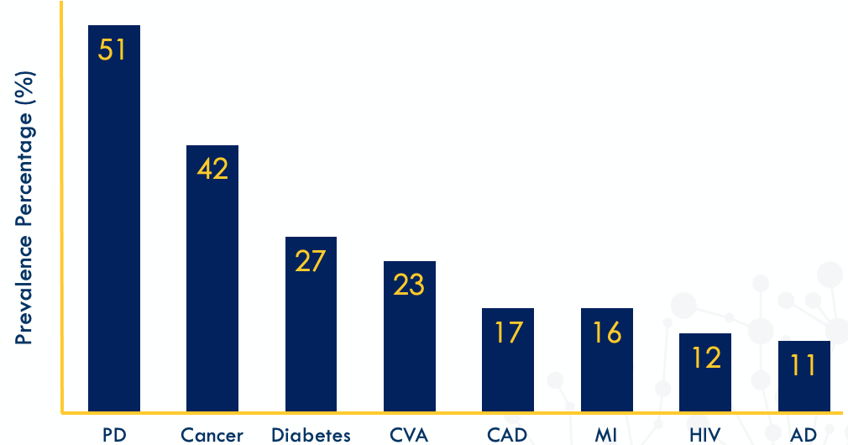
Depression Is Common In Patients With Many Chronic Diseases
PD = Parkinson’s Disease; CVA = Cardiovascular Accident; CAD = Coronary Artery Disease; MI = Myocardial Infarction; HIV = Human Immunodeficiency Virus; AD = Alzheimer’s Disease.
Preskorn. Primary Psychiatry. 2009;16(12):45-74.
Notes:
20
PD = Parkinson’s Disease;
CVA = Cardiovascular Accident;
CAD = Coronary Artery Disease;
MI = Myocardial Infarction;
HIV = Human Immunodeficiency Virus;
AD = Alzheimer’s Disease.

Slide 21
Major depression in the elderly
Community-Dwelling 1 - 9 %
Primary Care Settings 10 – 12 %
Hospitalized 11 – 45 %
Nursing Home 10-26%
Permanent Placement Up to 43%
Notes:
These are estimated prevalence rates of depression across various settings

Slide 22
Risk Factors for Depression in the elderly
Alcohol or substance abuse
Current use of a medication associated with a high risk of depression
Hearing or vision impairment severe enough to affect function
History of attempted suicide
History of psychiatric hospitalization
Medical diagnosis or diagnoses associated with a high risk of depression
New admission or change of environment
New stressful losses (loss of autonomy, privacy, functional status, body part, family member or friend)
Personal or family history of depression or mood disorder

Slide 23
Covid 19 and depression
WHO (March 2022): COVID-19 pandemic triggers 25% increase in prevalence of anxiety and depression worldwide
Healthcare workers are particularly at risk
young people are disproportionally at risk of suicidal and self-harming behaviours.
Question : will this persist as people adapt to the pandemic and learn to live with it?
Resilience typically follows trauma

Slide 24
Treatment Goals
Treat to remission
Avoid chronicity
Restore functionality

Slide 25
Importance of Achieving Remission
Physical Functioning^{1,2}
Occupational Functioning^{1,2}
Remission (or lack of it) can impact
Social Functioning^{1,2}
Marital Functioning⁴
Children’s Mental Well-being³
Likelihood of Future Episodes^{1,2}
Risk of Suicide⁵
Sobocki et al. Int J Clin Pract. 2006;60:791-798;
Keller. JAMA. 2003;289:3152-3160;
Weissman et al. JAMA. 2006;295:1389-1398;
Bromberger et al. J Nerv Ment Dis. 1994;182:40-44;
Judd et al. J Affect Disord. 1997;45:5-17.
Notes:
25
Key Points
There are a number of the potential consequences of untreated depression.
For the individual, both physical and occupational function can be compromised, as can one’s social life.^{1,2} Relationships with spouses can be put at risk.³ And, as Weissman’s research has shown, the mental health of children of depressed parents can be greatly impacted.⁴
Without complete remission, future episodes become more likely.^{1,2} And, of most concern, suicidality (suicidal ideation and suicidal attempts) can increase in those patients who do not achieve remission.⁵
Background
The naturalistic longitudinal observational study by Sobocki et al of 447 depressed patients found depressive symptoms to be associated with substantially decreased physical, mental, and social functioning. A longer time to, or lack of, remission was associated with negative consequences such as a greater likelihood of future episodes.¹
Keller conducted an expansive review of past, present, and future directions in depression treatment, reiterating the importance of achieving remission in treatment and outlining key physical and psychosocial factors involved in patients’ lives.²
Bromberger et al found nonremitted women to have higher dissatisfaction toward their husbands.³
One hundred fifty-one children (aged 7 to 17) whose depressed mothers were being treated with medication as part of the Sequenced Treatment Alternatives to Relieve Depression (STAR*D) trial were assessed to determine whether effective treatment of their mothers was associated with reduction of symptoms and diagnoses in the children.⁴
Judd et al looked at the impact of subsyndromal symptoms of depression (SSD) and found that persistent SSD were associated with increased lifetime suicidal ideation and suicide attempts.⁵
References
1. Sobocki P, Ekman M, Agren H, et al. The mission is remission: health economic consequences of achieving full remission with antidepressant treatment for depression. Int J Clin Pract. 2006;60:791-798.
2. Keller MB. Past, present and future directions for defining optimal treatment outcome in depression. JAMA. 2003;289:3152-3160.
3. Bromberger JT, Wisner KL, Hanusa BH. Marital support and remission of treated depression: a prospective pilot study of mothers of infants and toddlers. J Nerv Ment Dis. 1994;182:40-44.
4. Weissman MM, Pilowsky DJ, Wickramaratne PJ, et al. Remissions in maternal depression and child psychopathology: a STAR*D-child report. JAMA. 2006;295:1389-1398.
5. Judd LL, Akiskal HS, Paulus MP. The role and clinical significance of subsyndromal depressive symptoms (SSD) in unipolar major depressive disorder. J Affect Disord. 1997;45:5-18.

Slide 26
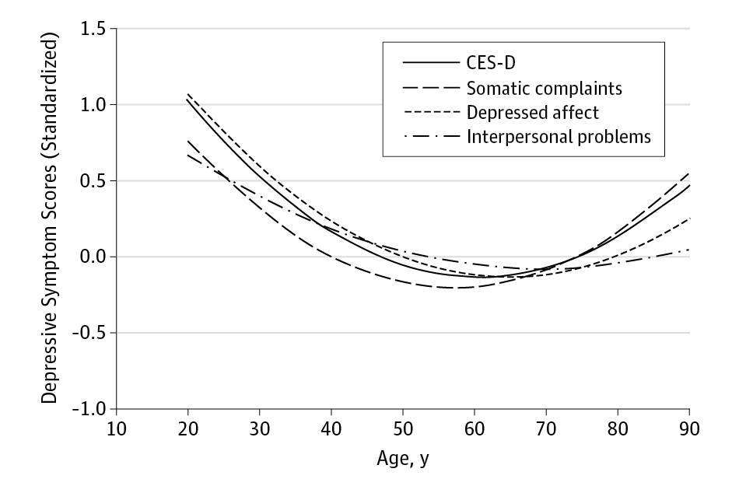
From: The Trajectory of Depressive Symptoms Across the Adult Life Span
JAMA Psychiatry. 2013;70(8):803-811. doi:10.1001/jamapsychiatry.2013.193
Figure Legend:
Scores for the Center for Epidemiologic Studies Depression Total Scale and 3 Subscales Across AdulthoodEstimated trajectory of scores for the Center for Epidemiologic Studies Depression (CES-D) total scale and 3 subscales across adulthood. Raw scored were z-transformed so that all scales could be plotted on the same axis. (eFigure 1 in the Supplement shows the estimated trajectories of each scale in the original metric.)

Slide 27
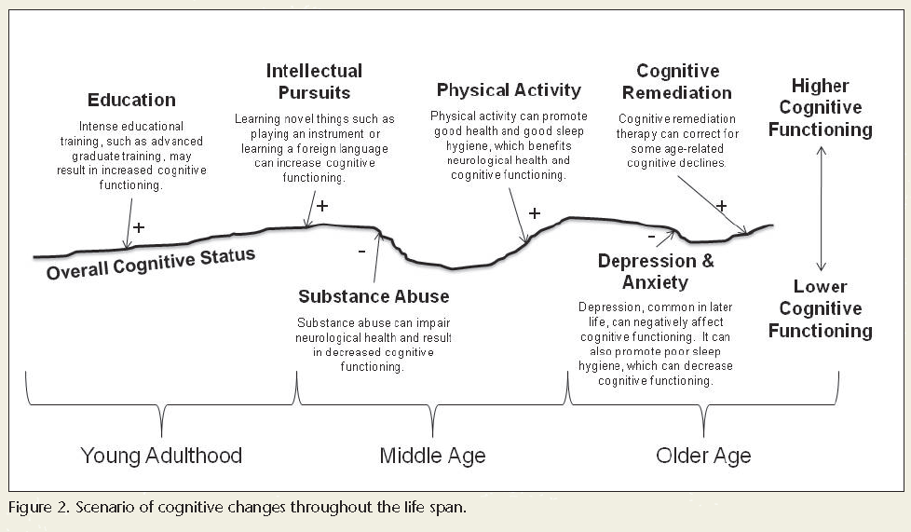
Vance DE et al. J Psychosoc Nurs Ment Health Serv. 2010 Apr;48(4):23-30.

Slide 28
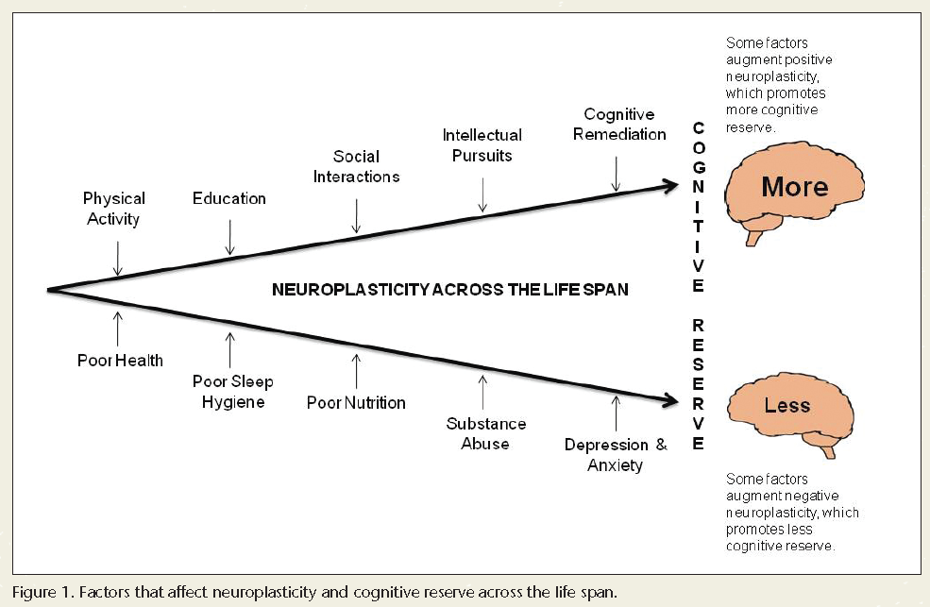
Vance DE et al. J Psychosoc Nurs Ment Health Serv. 2010 Apr;48(4):23-30.

Slide 29
Depression treatment
3 pillars of treatment :
1. Psychotherapy
2. Medication Therapy (Pharmacotherapy)
3. Exercise

Slide 30
First Line Treatment
Pharmacotherapy or focused psychotherapy (CBT)?
Pharmacotherapy preferred if:
No motivation
No access to psychotherapy
Severe symptoms
Urgency in treatment response
Pharmacotherapy + psychotherapy may be best approach in more complex and/or chronic cases

Slide 31
Psychotherapy
1. Cognitive behavioural therapy – CBT
2. Supportive psychotherapy
3. Psychodynamic Psychotherapy
4. Interpersonal Psychotherapy - IPT
5. Acceptance and Commitment Therapy - ACT

Slide 32
Antidepressants 2021
TCA
SSRI
NDRI
Amitriptyline
Imipramine
Clomipramine
Trimipramine
Maprotiline
Amoxapine
Nortriptyline
Desipramine
Citalopram [Celexa]
Escitalopram [Cipralex]
Fluoxetine [Prozac]
Fluvoxamine [Luvox]
Sertraline [Zoloft]
Paroxetine [Paxil]
Bupropion-SR/XL [Wellbutrin]
SNRI
Duloxetine [Cymbalta]
Venlafaxine-XR [Effexor]
Desvenlafaxine [Pristiq]
Levo-milnacipran [Fetzima]
SARI
Trazodone
NaSSA
MAOI
Mirtazapine [Remeron]
Phenelzine
Tranylcypromine
Multimodals
RIMA
Vortioxetine [Trintellix]
Vilazodone [Viibryd]
Moclobemide [Manerix]
Notes:
32
DISCUSSION NOTES:
Just to show that there are many antidepressants available today, with varying modes of action.
TCA = tricyclic antidepressant
MAOI = monoamine oxidase inhibitor
SSRI = selective serotonin reuptake inhibitor
SARI = serotonin antagonist and reuptake inhbitor
NDRI = noradrenaline and dopamine reuptake inhibitor
SNRI = serotonin noradrenaline reuptake inhibitor
NaSSA = noradrenaline and specific serotonin antagonist
RIMA = reversible inhibitor of monoamine oxidase
Just to show that there are many antidepressants available today, with varying modes of action.
TCA = tricyclic antidepressant
MAOI = monoamine oxidase inhibitor
SSRI = selective serotonin reuptake inhibitor
SARI = serotonin antagonist and reuptake inhbitor
NDRI = noradrenaline and dopamine reuptake inhibitor
SNRI = serotonin noradrenaline reuptake inhibitor
NaSSA = noradrenaline and specific serotonin antagonist
RIMA = reversible inhibitor of monoamine oxidase A

Slide 33
Exercise
What counts as exercise? Moderate or greater physical activity for at least 20 minutes at a time (e.g. a brisk walk, intense housework, cycling, swimming etc.)
How much exercise is needed for it to help? Ideally, a minimum of 2 hours per week and better if 3 hours per week or more. But it is also true that any exercise is better than none.
What is the best exercise to do? The one you like and will continue doing.
What does exercise do? Releases BDNF (brain derived neurotrophic factor) which has a positive effect on mood and reduces anxiety

Slide 34
Basic Management Principles
First-line antidepressant
Target the symptoms
Avoid side effects
Second antidepressant of a different class
Adjunctive therapy/Combination AD
Neuromodulation (rTMS, ECT, ketamine)
Experimental strategies (VNS, DBS)
Appropriate psychotherapy & Exercise

Slide 35
Questions and Discussion
Thank you !
Howard c Margolese, MD, CM, Msc, FRCPC

