Slide 1
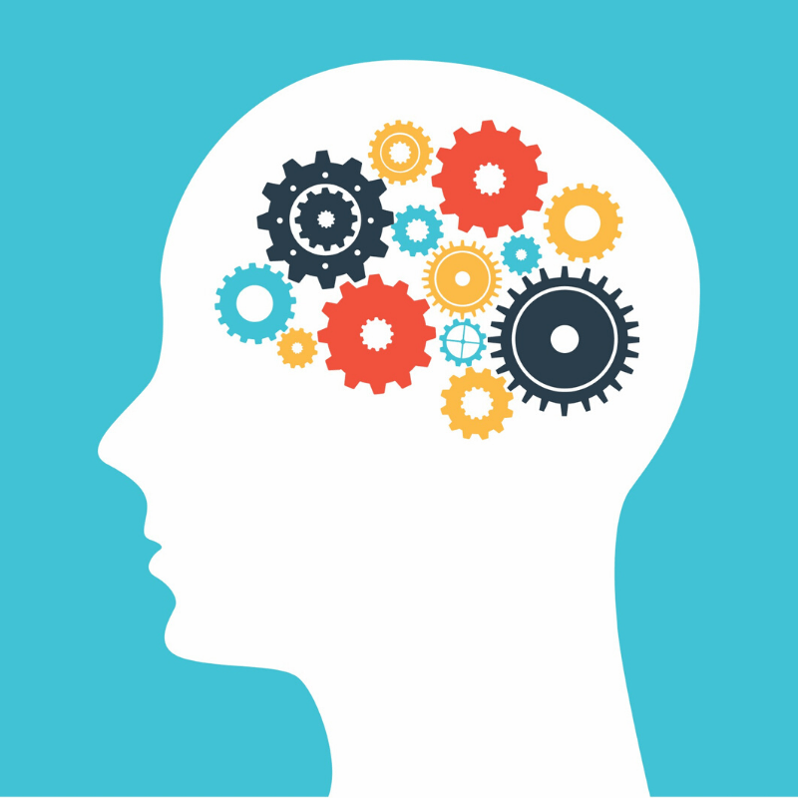
Check Up From the Neck Up
Rona Milch Novick, PhD

Slide 2
Why Now?
An unbelievable year
The road ahead is unclear
Our mental skills and mental wellness are important always

Slide 3
What’s On Your Mind?

Slide 4
Was it . . .
Worry
To Do
Memory
Daydream
I wish . . .

Slide 5
A story of thoughts

Slide 6
The Power of Thought
Thought influences behavior, physiology, and other thoughts
Thoughts can have positive, negative or neutral influence
Thoughts can be learned – and can become habitual

Slide 7
Negative Thought Habits
Common thought pitfalls
Generally, such thinking is
self-destructive,
keeps us stuck,
drives anxiety and depression

Slide 8
Common Negative Thoughts
Which have become your habit? Do you see yourself here?

Slide 9
I can’t learn anything on-line!
Covid has ruined everything.

Slide 10
There are increased cases in some states – nothing is safe.
Getting together with one or two friends is useless – unless everyone can hang out.

Slide 11
I know no one will want to join me for Pizza.
Not having that teacher in person will ruin my GPA and I’ll never get to college.

Slide 12
I’m the only idiot still afraid of Covid
I should feel more comfortable being out with friends.

Slide 13
Max is a loser, he is crazy about germs.
That test was too hard – the teacher was out to get me

Slide 14
Two Essential Questions
Is this thought true?
Is this thought helpful?

Slide 15
Mental Housekeeping
Know your negative thought habits
1
Catch yourself when engaging in negative thought habits
2
Ask the two essential questions
3
CLEAN HOUSE!!!
4
Refocus/reframe
Distraction
Create new mantra - Avoid polyanna statements

Slide 16
“Vaccine” Against Negative Thought Patterns
Gratitude
Exercise
Social connection/reality checks
Basic Biology

Slide 17
Developing Skills to Promote Mental Wellness
Relaxation
Mindfulness
Imagery
Breathing

Slide 18
A Jewish Idea: We Harness Our Thoughts
The way Rebbe Nachman puts it, you’re the rider and your thoughts are the horse (Likutey Moharan II, 50). The Rebbe’s analogy tells us that not only can we train our thinking and regain control over it when it veers off course, but that it’s normal for it to run astray, so there’s no reason to panic! The challenge is to remember that you are the rider. You have to dominate the horse and subdue it. The challenge exists because the horse/thought seems to be as independent as you. Not so. God made it to truly look and seem that way in order that we should have free will. In fact, anyone who wants to can control and ride the horse. (Based on Breslov Rabbi, Likutey Halakhot, Shutfin 5:35)

Slide 19
Conclusions
We are what we think
We can decide what we think
It takes time to change thought habits
Pirkei Avot: The task is great, but neither are you free to desist from it.
Start somewhere! Start today! Challenge your thought habits . . . But be patient.

Slide 20
Thank you Shabbat Shalom

