Slide 1
Resilience: Getting Back to Normal When Things Are Not Normal Jewish Community Mental Health Awareness Shabbat
Rona Milch Novick, PhD
Dean

Slide 2
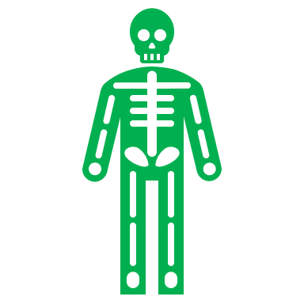
Our Resilience Journey Tonight
Context - where we have been and what lies ahead as our unchangeable context
Definition – what is resilience?
Contributors – where does resilience come from?
***************************************************
Routes to resilience
Anatomical
Behavioral
Cognitive

Slide 3
This year we’ve been challenged to
Entertain ourselves
Become educators
Operate home offices
Become chefs & short order cooks
Connect from a distance
Manage with less
Work and multi-task more
And we have risen to many challenges!

Slide 4
Our New Not-Normal
Uncertainty
Unknown Duration/Intensity
Real life impacts

Slide 5
Defining Our Goal: Resilience
APA Road to Resilience definition: process of adapting well in the face of adversity, trauma, tragedy, threats, or significant sources of stress
Resilience is that ineffable quality that allows some people to be knocked down by life and come back stronger than ever. Rather than letting failure overcome them and drain their resolve, they find a way to rise from the ashes. Even after misfortune, resilient people are blessed with such an outlook that they areable to change course and soldier on.

Slide 6
Resilience – Bouncing Forward?
Resilience is commonly thought of as ‘bouncing back’ like a spring to our pre-crisis norm. However, when events of this magnitude occur, we cannot return to ‘normal’ life as we knew it before September 11.
A more apt metaphor for resilience might be ‘bouncing forward’, to face an uncertain future. This involves constructing a new sense of normality as we recalibrate our lives to face unanticipated challenges ahead.
-Froma Walsh, Family Process, 41:34-36, 2002

Slide 7
Where Does Resilience Come From?
Temperament
Experience
Examples/Role Models
Learned Behaviors

Slide 8
Everyone can be a resilience agent
Resilience is not a genetic trait.
Derived from the ways we learn to think and act when faced with obstacles.
Supportive relationships with parents, teachers and others can cultivate an approach to life that views obstacles as a critical part of success.
Celebrate failures and mistakes as part of the learning process

Slide 9
Resilience Through Experience: Stress as Strengthener
Experiencing stress may strengthen resistance to later stress – “steeling effect”
Repeated parachute jumps – decreased physiological and subjective stress
Early healthy separations – better adaptation to hospital admission

Slide 10
From Negative (sensitization) to Postive (steeling and resilience)
What allows stress/adversity to result in steeling vs. sensitization?
Successful coping
Physiological adaptation
Psychological habituation
Cognitive redefinition of experience
Self-efficacy

Slide 11
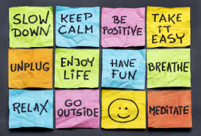
Routes to resilience

Slide 12
Getting From Here to There: The Road to Resilience
Accept/know where you are – note your struggles
Permission to be human
Learning skills/building strength takes time

Slide 13
Physiology and Resilience
Where does your stress live in your body?
Genetic loading
We are both controlled by and control our physiology

Slide 14
Impacting Physiology
Do any of these work for you?
music
reading, writing
talking to someone
fresh air
distraction
exercise
Do you routinely?
Meditate, do yoga, exercise, do breathing exercises
All these are teachable skills

Slide 15
Impacting Physiology Directly and Indirectly
Sleep
Exercise
Nutrition
Relaxation
Imagery
Meditation/
Mindfulness

Slide 16
Behavior and Resilience
Fight/flight pre-wired response
Avoidance – natural response to stress - to limited degree may be healthy
Approach - coping

Slide 17
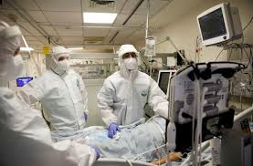
An Important Behavior: Media and Social Media Choices
Like Goldilocks – needs to be just right
Monitor TV, social media and other sources of information
Monitor your discussions in front of children

Slide 18
An Important Behavior: Connection
Social engagement
Casual connections/interactions
Friendships

Slide 19
Building Resilience by Changing Behavior
Make approach approachable – take small steps
Start with easiest and build on success
Encourage movement beyond the comfort zone
Predict, allow, encourage failure
Be patient

Slide 20
Cognition (Thinking) and Resilience How we see the world and ourselves
Inevitable
Uncontrollable
Negative, dangerous
Forever, static
Growth mindset
Effective, capable
Work in progress
Forgiving vs. judgmental

Slide 21
Resilient Life Views
Change is part of living
Celebrating movement towards goals – even small goals
Avoid seeing crises as insurmountable – why current situation is particularly challenging
The role of faith

Slide 22
Building Resilience by Changing Your Thinking
Ask is it real?
Ask is it helpful?

Slide 23
Transcending Categories: Spirituality Meaning-making Generosity

Slide 24
The Gift of Faith
Supports well-being
Dealing with the unknown and unseen
Provides behavior and cognitive paradigms for resilience
Routines, rituals, traditions
Endless opportunity for change & growth

Slide 25
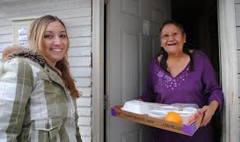
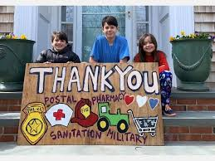
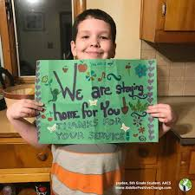
Meaning Making and Generosity
While simplistic meaning making can backfire (prayer as curative) giving meaning to our lives and action gives us strength
Acts of generosity/caring/gratitude help others but strengthen us

Slide 26
Chazak, Chazak, v’nitchazek
Thank you!

